Slide 1
Job Location Suggestion
Aswini Pusuluri, Gianni DeGuzman, Sowmya Ravichandran, Vishalakshi Ramanathan
Group No: 3

Slide 2

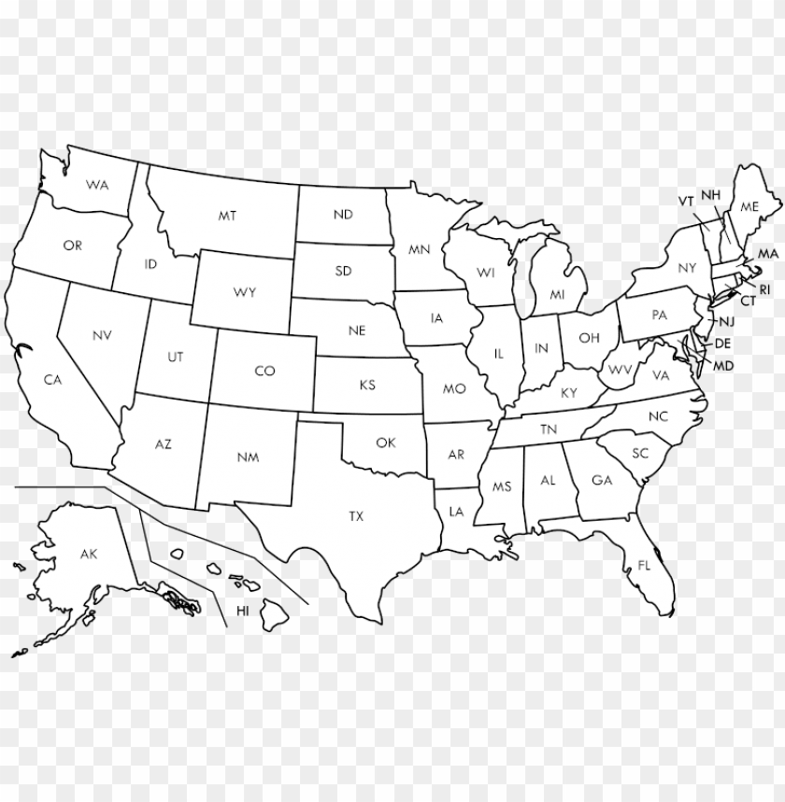
Overview
We are at a point in our studies and careers where we are looking forward to our future job roles and need to consider where to settle
Want to create a model which predicts a location based on our needs such as salary, weather, prospects, etc.

Slide 3
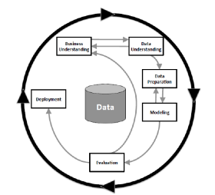
CRISP-DM
Following the CRISP-DM process

Slide 4
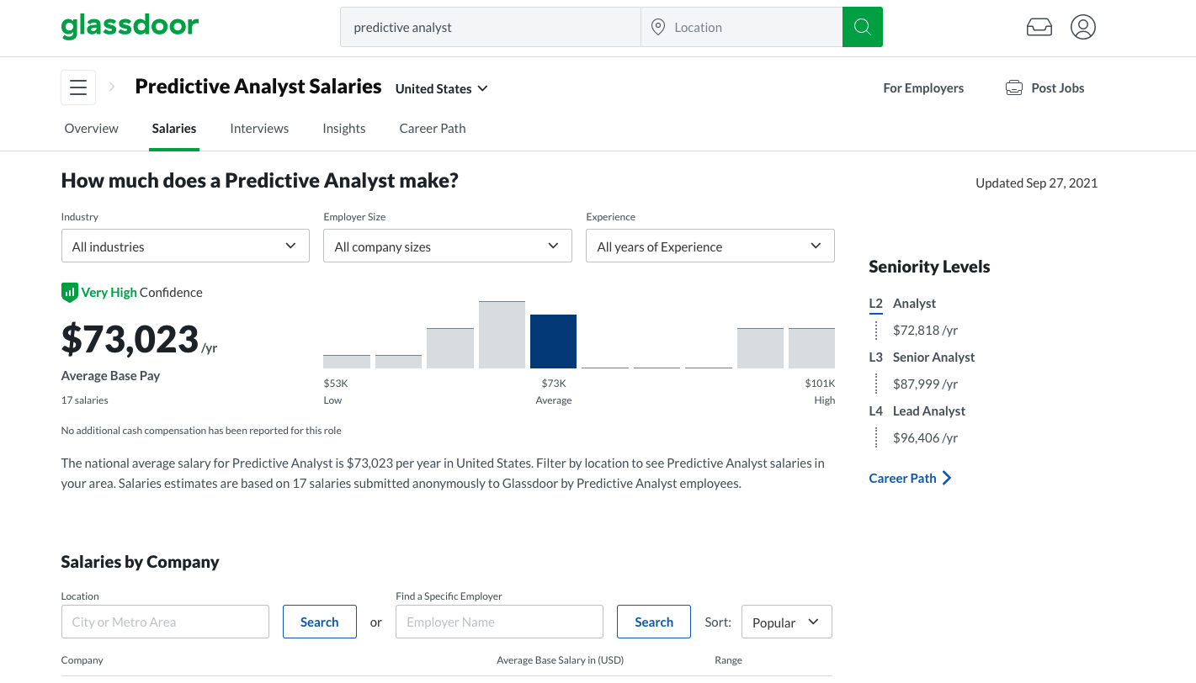
Existing System
There are many websites such as glass door , levels fyi where the salary is predicted based on location , job roles ,years of experience and so on.

Slide 5
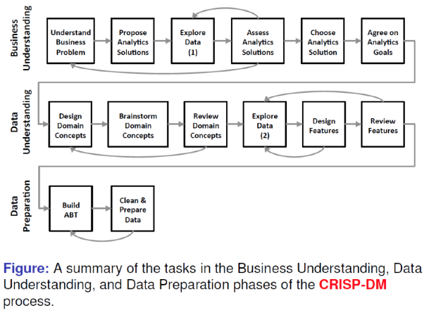
Motivation
Understanding the business problem:
Currently no system that predicts location based on needs
Would require extensive time researching places, jobs, etc.
Suggestion would cut down on time spent and provide focal points of research

Slide 6




Approach
Proposed Analytics Solution:
We want our model to predict a location based on an individual’s preference in the form of a query
Query would need to include features such as Job Title, Company Names, Years of Experience, Salary, Preferred Livability among others
These requirements will be used to predict the most preferred location for the individual to work
4 sources of data:
FYI_levels
Weather_data
Tech_employment_count
livability_score

Slide 7
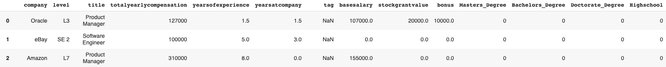

Data Overview - levels_FYI
levels_FYI dataset
Contains information about Job Listings (Salary, Company, Experience, Location, etc)

Slide 8
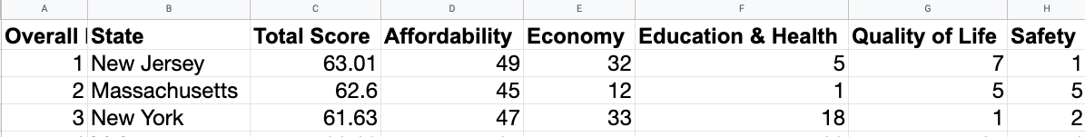
Data Overview - livability_score
Best States to Live dataset
Ranked list of states in the US based on Affordability, Economy, Education & Health, Quality of Life, and Safety
Notes:
Speak on how dataset is clean ( refer to how it is already ranked )
Dropping Total Score - Take the remaining features

Slide 9
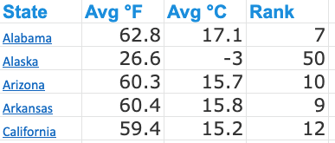
Data Overview - weather_data
Weather_data dataset
Average daily temperature with rank based on other factors
Notes:
Speak on how dataset is clean

Slide 10
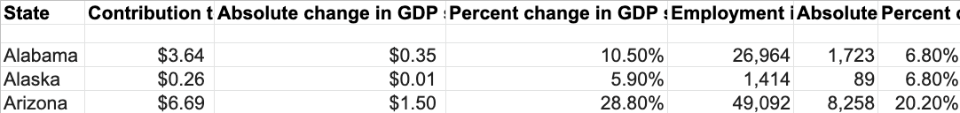
Data Overview - tech_employment_count
Tech_employment_count dataset
Contains each state’s tech workforce amounts
Notes:
Do Data Characteristics for as well - remove ‘since 2014) keeping all features

Slide 11
Data Characteristics - levels_FYI
Accuracy
Instances of inaccuracy which need fixing with further data engineering
Levels - column
Completeness
Base salary, tags, and education have missing values
Nearest neighbor imputation
Mode imputation
Reliability
FYI - https://www.levels.fyi/?compare=Google,Facebook,Microsoft&track=Software%20Engineer
Relevance
Location of job is the target feature so we included data regarding jobs (FYI levels, tech employment) and the cities/states (Livability, weather)
Timeliness
Data is recent
Notes:
Add links for reliability/source

Slide 12
Data Characteristics - livability_score
Accuracy
Metrics generated from Bureau of Labor Statistics Data
Completeness
No missing data
Reliability
Methodology here:
https://wallethub.com/edu/best-states-to-live-in/62617
Relevance
Model takes the state’s features into consideration
Timeliness
Findings published in 2021

Slide 13
Data Characteristics - weather_data
Accuracy
Data pulled from National Centers for Environmental Information
Completeness
No missing data
Reliability
Methodology here:
https://www.currentresults.com/Weather/US/average-annual-state-temperatures.php
Relevance
Weather preference is considered in the prediction
Timeliness
Published in 2021

Slide 14
Data Characteristics - tech_employment_count
Accuracy
Data from Economist Intelligence Unit
Completeness
No missing data
Reliability
Methodology here:
https://www.vox.com/2017/9/26/16346960/software-industry-growth-kansas-indiana-idaho-north-carolina
Relevance
Provides more context for states’
Timeliness
Recently published

Slide 15
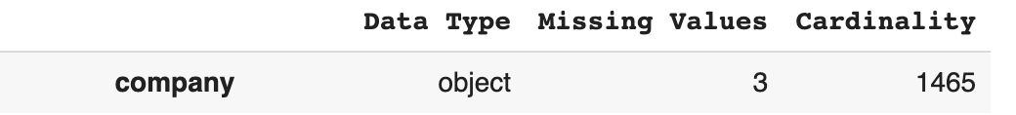
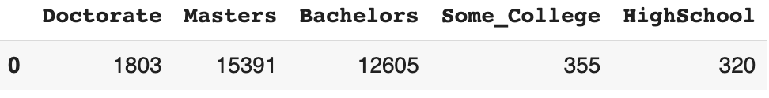
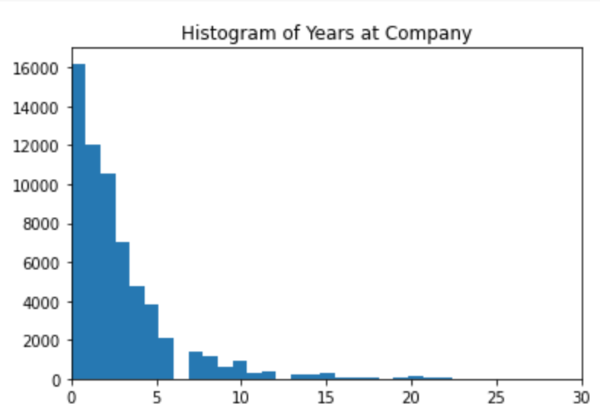
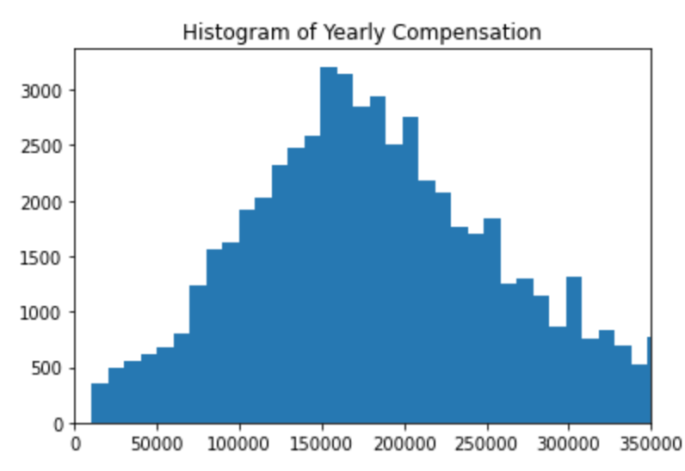
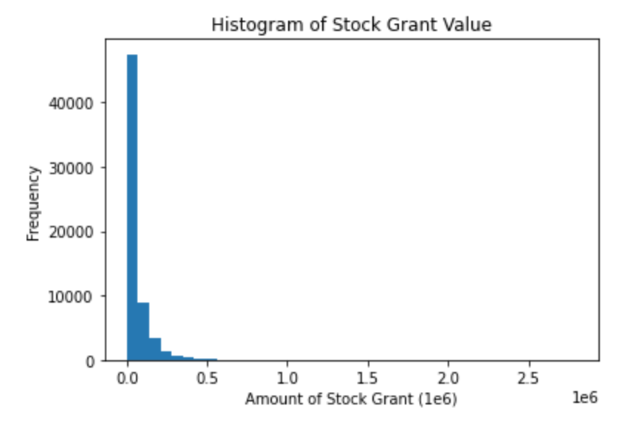
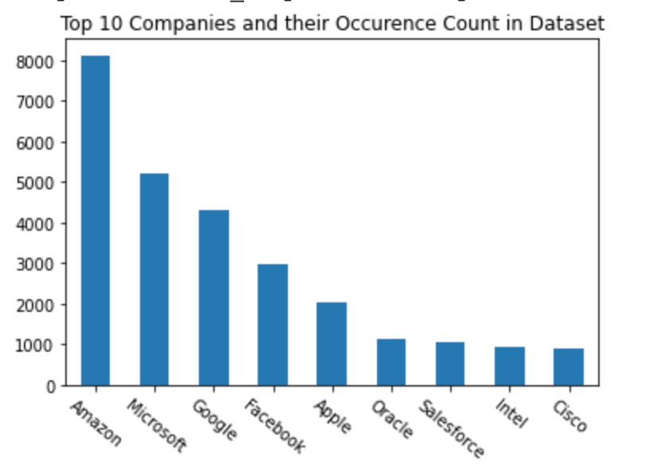
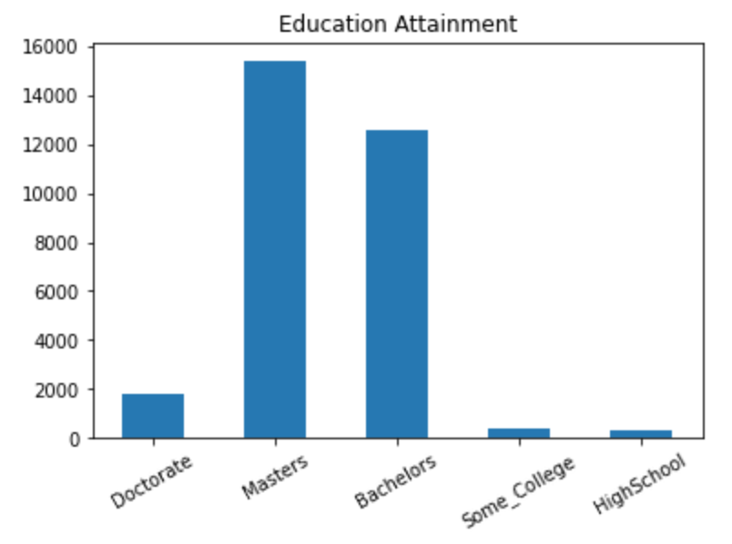
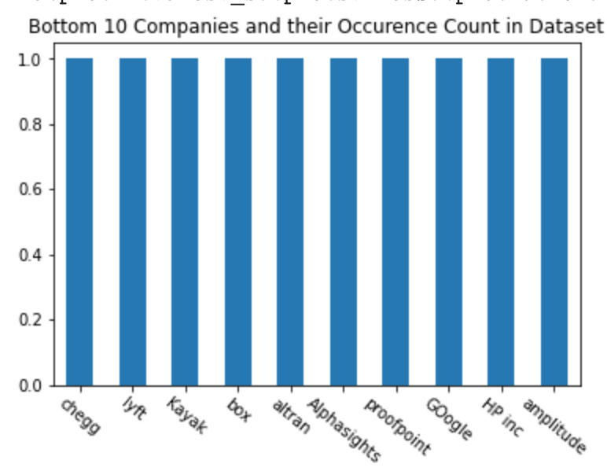
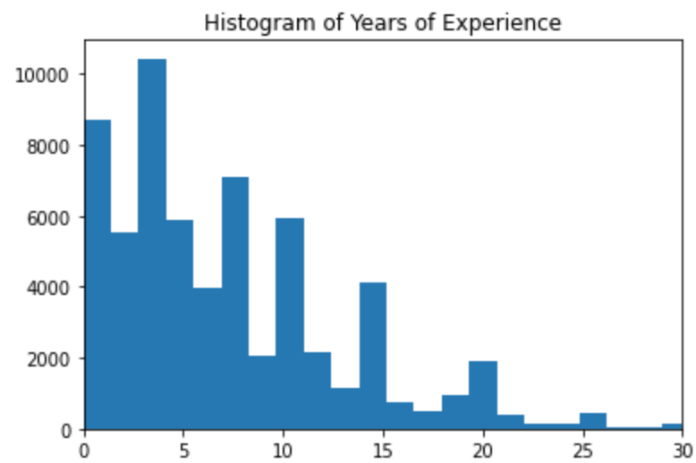
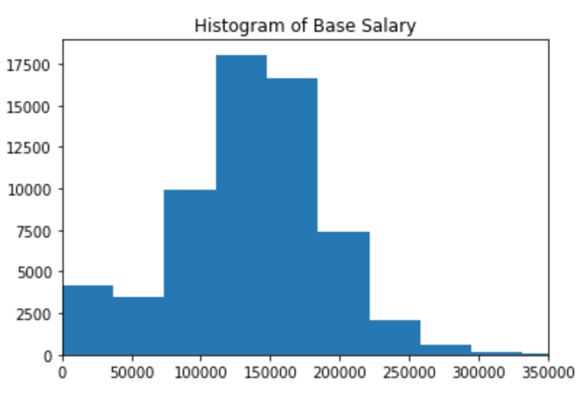
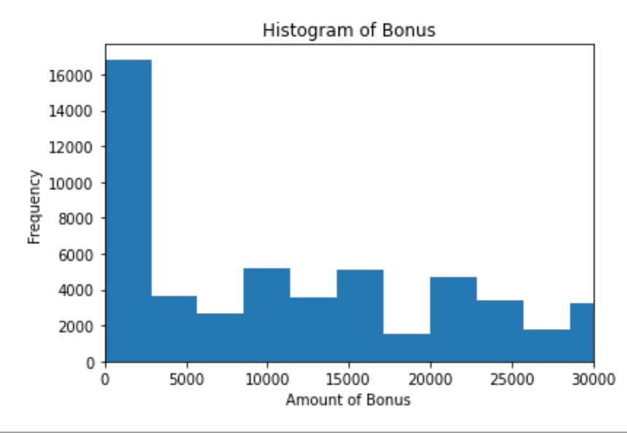
Data Exploration - Raw

Slide 16
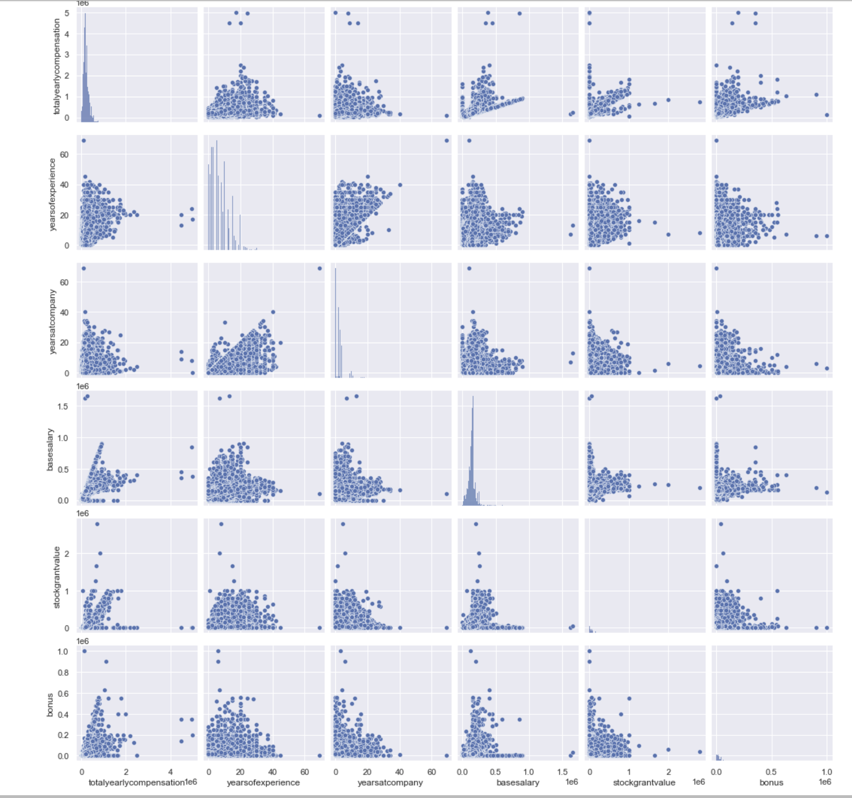
Data Exploration - Pair Plot

Slide 17
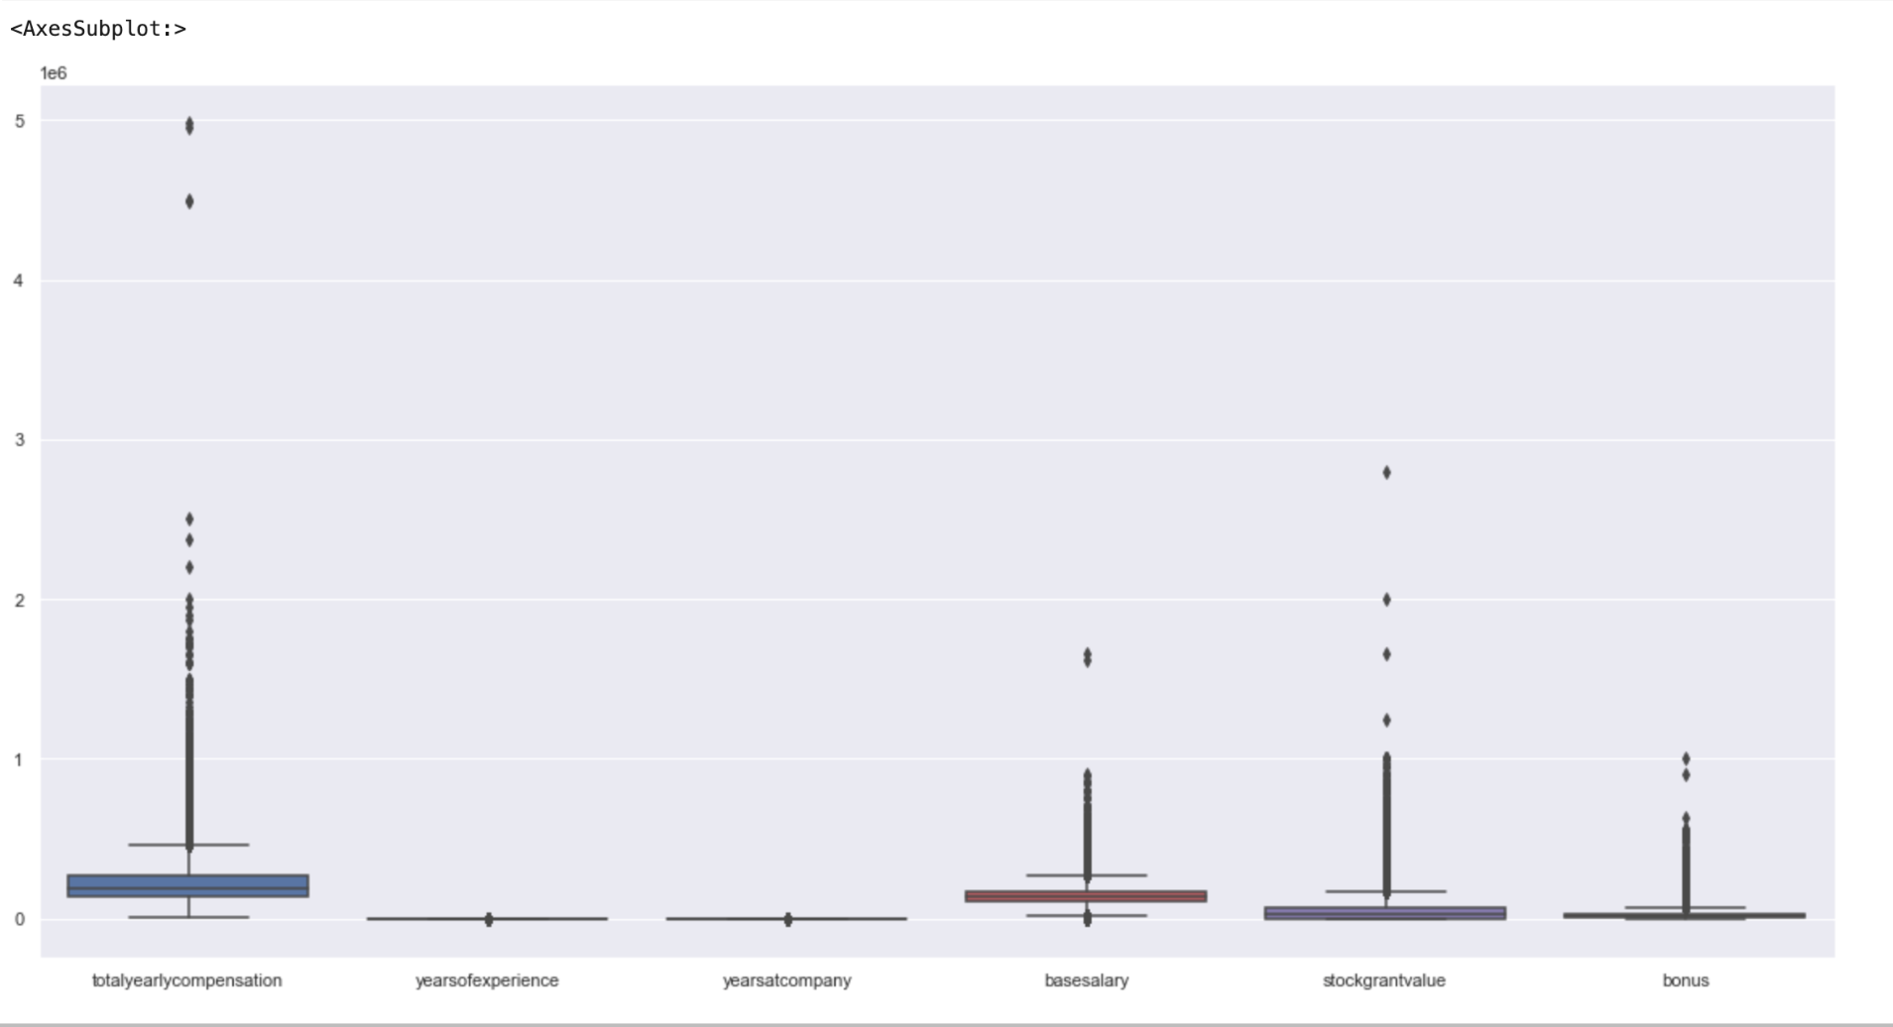
Data Exploration - Box Plot

Slide 18
Data Processing - Steps
Inconsistencies
“Levels” column needs to be divided into 4 levels
Missing values
“Base Salary” has 5% missing values
Nearest Neighbor imputation
Mode imputation
Tag
Education
Bonus
Stockgrantvalue
Dropping Values
Many columns (cityid, rownumber,timestamp,etc.) will be dropped as they are not relevant to location
Binning
States can be categorized (good, average, bad) based on weather rank, livability score, employment count
Categorical Values
Converted using one-hot encoding

Slide 19
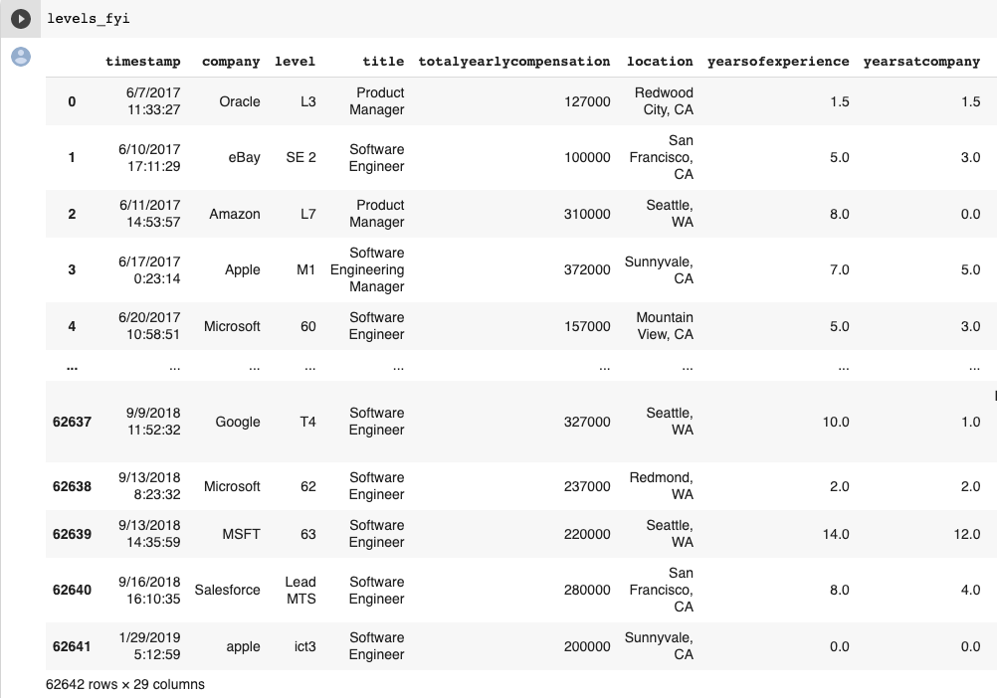
Data Processing- Raw Dataset

Slide 20
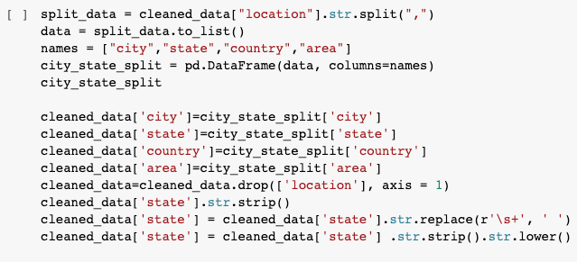
Data Processing - Cleaning

Slide 21
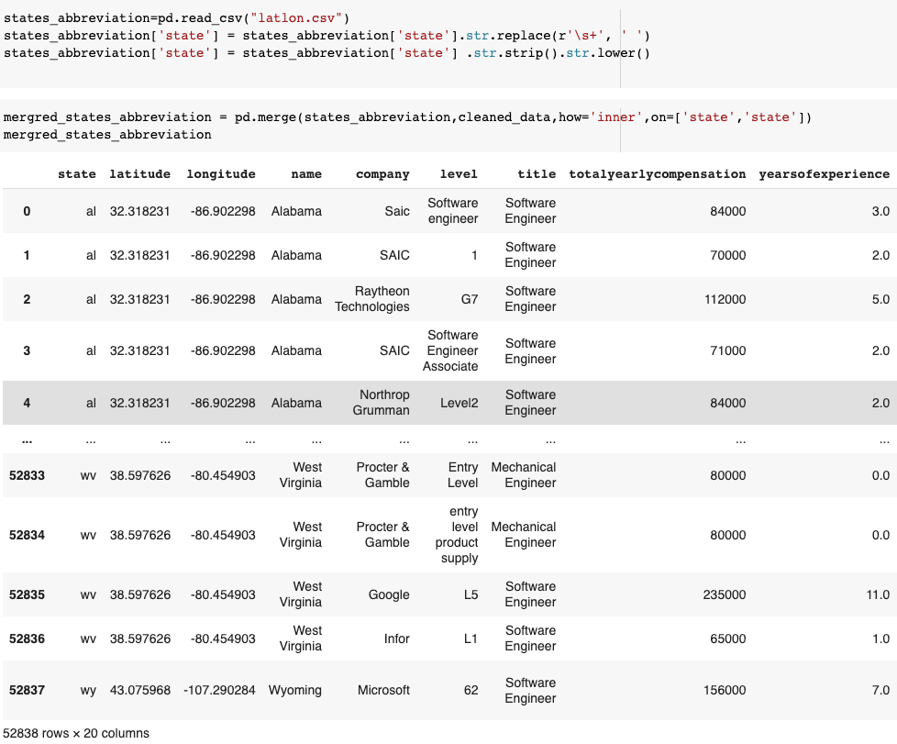
Data Processing - Merging Data Sources

Slide 22
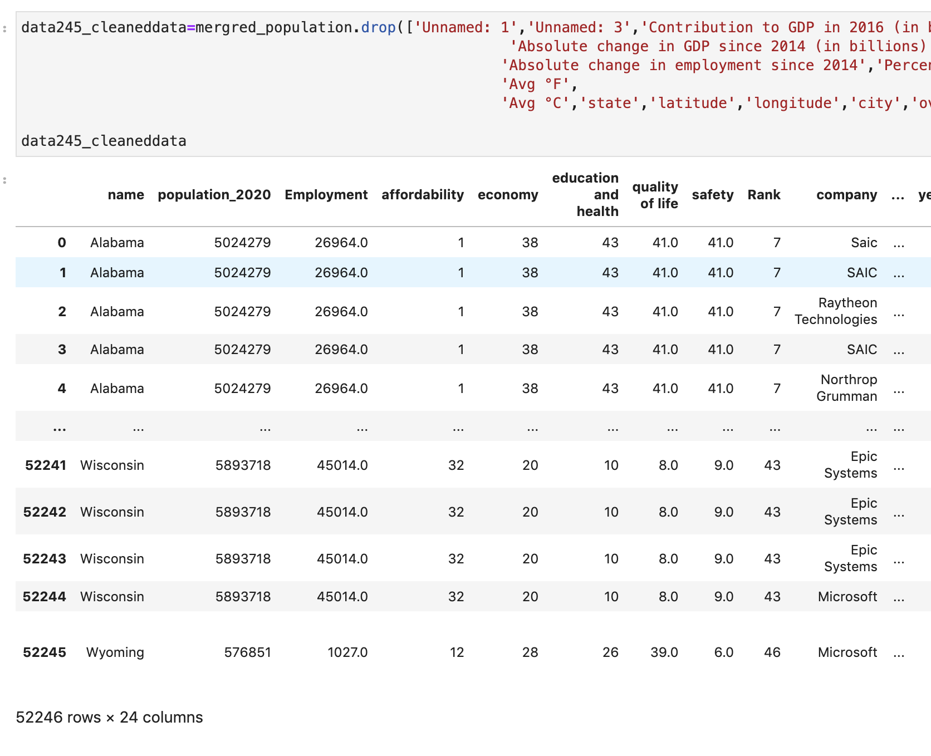
Data Processing - Dropping Features

Slide 23
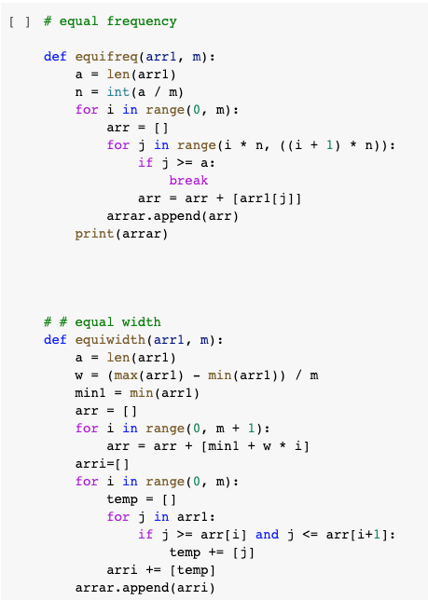
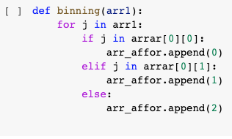
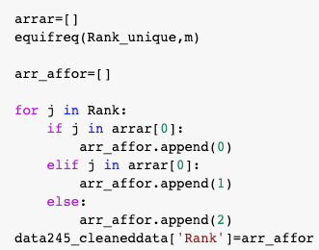
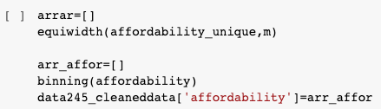
Data Processing - Binning

Slide 24
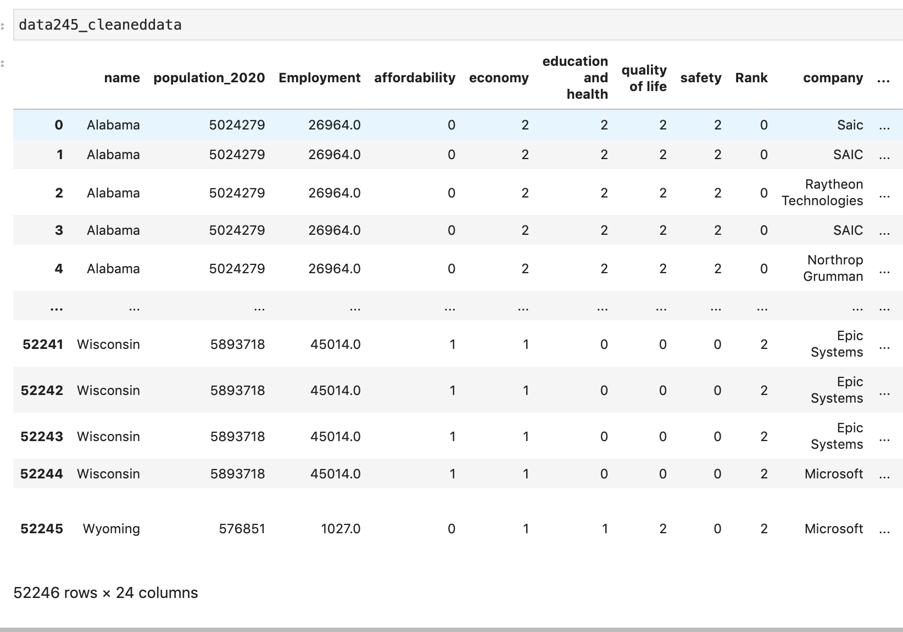
Data Processing - Cleaned (tentative)

Slide 25
Progression
Understand business problem
Need a prediction system to aid in deciding on location to settle
Propose Analytics Solution
Prediction model to suggest cities based on preferences (query)
Explore Data
Currently data needs more processing
Assess Analytics Solutions, Choose Analytics Solution, Agree on Analytics Goals
Try different models after completing processing and then decide

Slide 26
Completed Task
Currently we have completed Domain understanding, Data understanding and in Data preparation we dropped irrelevant columns, merged the data sources, converted livability score and weather data into categorical values, implemented one-hot encoding in education column.
Notes:
Please change the picture to data preparation and also the write up

Slide 27

Current Phase

Slide 28
Data Processing - Remaining Task
Missing Values
Calculate Job Opportunity Ratio
Fix inconsistencies
Normalize continuous values

Slide 29
Timeline
September 1 - September 15
Business Understanding
Design Domain Concepts
Brainstorm Domain Concepts
Review Domain Concepts
September 15 - September 30
Data Understanding
Data Exploration
September 30 - October 30
Design Features, Review Features
Cleaning Data
Data Transformation
October 30 - November 10
Build ABT, Clean & Prepare Data
November 10 - November 24
Modeling, Evaluating
November 24 - December 1
Deployment, Presentation

Slide 30
Data Sources
https://www.levels.fyi/?compare=Google,Facebook,Microsoft&track=Software%20Engineer
https://www.currentresults.com/Weather/US/average-annual-state-temperatures.php.
https://www.vox.com/2017/9/26/16346960/software-industry-growth-kansas-indiana-idaho-north-carolina.
https://wallethub.com/edu/best-states-to-live-in/62617

Slide 31

Questions?

